Slide 1
7th Grade
Final Exam Study Guide
Technology Education
Mr. Poliszuk

Slide 2


Technology 7 Final Exam
Learning Target:
  Complete the final exam to the best of your ability.
Testing Strategies
  Take your time
  If you’re unsure, skip it and go back to it later
  Eliminate wrong answers, make educated guess using context clues
  Do your best!!

Slide 3
Technology Education
Learning Targets:
  Analyze 7th grade curriculum content.
  Review for the final exam.
Do Now:
  What are the benefits of passing final exams?
  What are the downfalls to failing final exams?

Slide 4
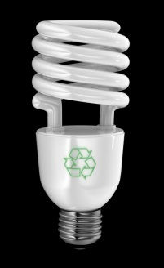
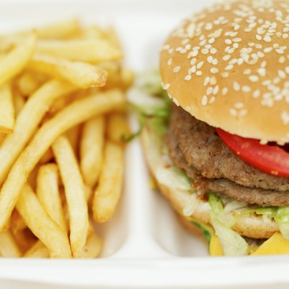
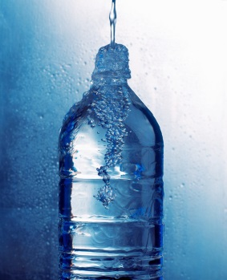
Learning Targets:
Analyze 7th grade curriculum content.
Review for the final exam.
Technology!
  Created by humans
  Effects humans positively and negatively
  Something we cannot live without
Definition:
  Need – something we cannot live without
    Examples: Food, Water, and Shelter

Slide 5
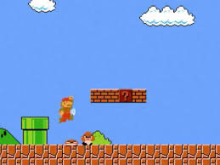
Learning Targets:
Analyze 7th grade curriculum content.
Review for the final exam.
Definition:
  Want – Something we can live without.
    Examples: Xbox, iPods, Ear Rings, Dish Washer
Technology impacts people both negatively and positively.
  Example:
    Positive – electricity makes life easier!
    Negative – generating electricity can pollute the environment.

Slide 6
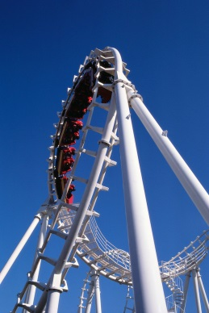
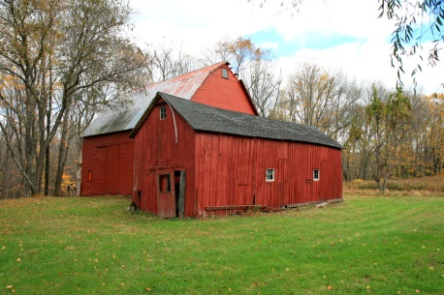
Learning Targets:
Analyze 7th grade curriculum content.
Review for the final exam.
Definition:
  Society – the relationships among people.
Technology is created by humans to satisfy our needs and wants.
  Example:
    We need farms for food and houses to live.
    We want iPods, iPhones, roller coasters, because they are fun!!

Slide 7
Learning Targets:
Analyze 7th grade curriculum content.
Review for the final exam.
Input
Process
Output
Feedback
A set of related parts that work together to accomplish a purpose is called a System.

Slide 8
Learning Targets:
Analyze 7th grade curriculum content.
Review for the final exam.
Input
Process
Output
Feedback
The result of the operation of a system:

Slide 9
Learning Targets:
Analyze 7th grade curriculum content.
Review for the final exam.
Input
Process
Output
Feedback
Using Output to regulate or control inputs and/or processes is called:

Slide 10
Learning Targets:
Analyze 7th grade curriculum content.
Review for the final exam.
Input
Process
Output
Open Loop System
Closed Loop System (has feedback)
Input
Process
Output
Feedback

Slide 11
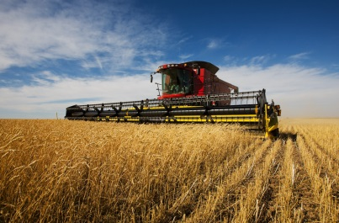
Learning Targets:
Analyze 7th grade curriculum content.
Review for the final exam.
Agricultural and Biotechnology
  Developing and using devices and systems to plant, grow and harvest crops.
Energy and Power Technology
  Developing and using devices and systems to convert, transmit, or process energy.
Construction Technology
  Using systems and processes to put structures on the sites where they will be used.

Slide 12
Learning Targets:
Analyze 7th grade curriculum content.
Review for the final exam.
Transportation Technology
  Developing and using devices and systems to move people and cargo from an origin point to a destination.
Manufacturing Technology
  Developing and using devices and systems to convert materials into products in a factory.
Medical Technology
  Developing and using devices and systems to promote health and cure illness.

Slide 13


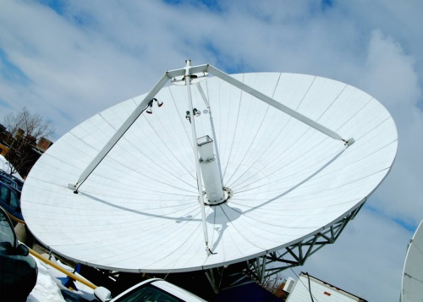
Learning Targets:
Analyze 7th grade curriculum content.
Review for the final exam.
Information and Communication Technology
  Developing and using devices and systems to gather, process, and share information and ideas.

Slide 14
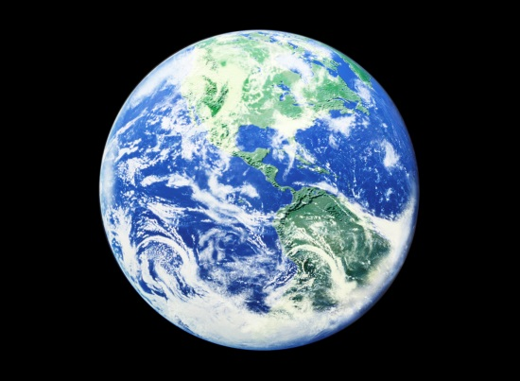



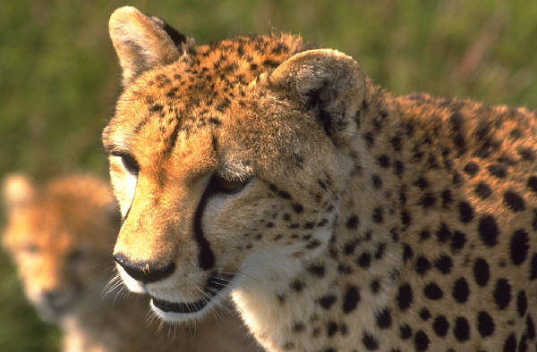
Learning Targets:
Analyze 7th grade curriculum content.
Review for the final exam.
SCIENCE!!!
  Definition: The study of the natural world.

Slide 15
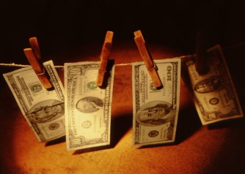
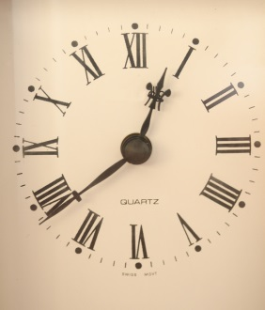
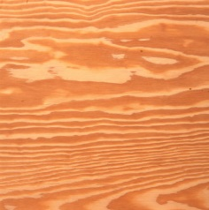
Learning Targets:
Analyze 7th grade curriculum content.
Review for the final exam.
To create Technology, we need:
Tools
Information
Capital
Time
Energy
Materials
People

Slide 16



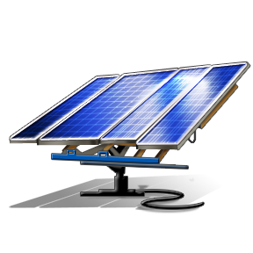
Learning Targets:
Analyze 7th grade curriculum content.
Review for the final exam.
Power/ energy technology

Slide 17

Learning Targets:
Analyze 7th grade curriculum content.
Review for the final exam.
Biotechnology
  Prefix: Bio – means “life”
  Definition: Using biology to create technology

Slide 18
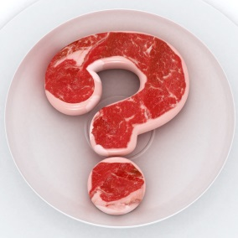

Learning Targets:
Analyze 7th grade curriculum content.
Review for the final exam.
Engineering Design Process
  Identify the problem
  Explore ideas
  Plan and develop
  Test, evaluate and modify
  Present the solution

Slide 19
Learning Targets:
Analyze 7th grade curriculum content.
Review for the final exam.
Input
Process
Output
Feedback
Engineering Design Process
Make the best product possible
Closed-Loop System

Slide 20
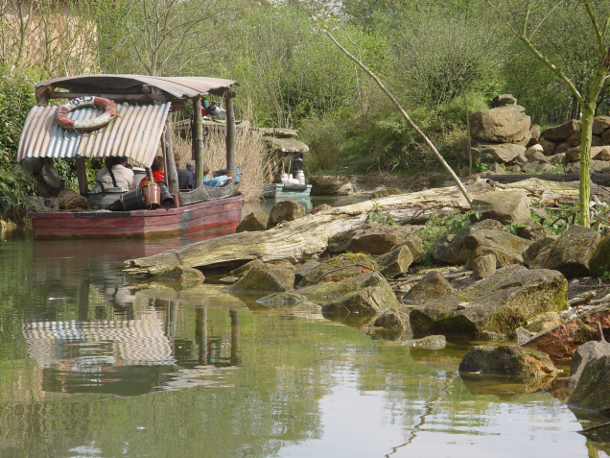
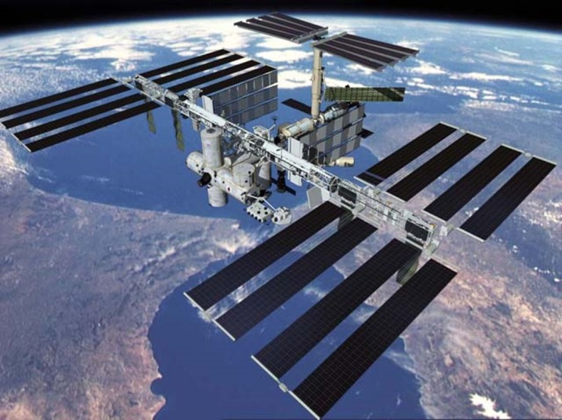
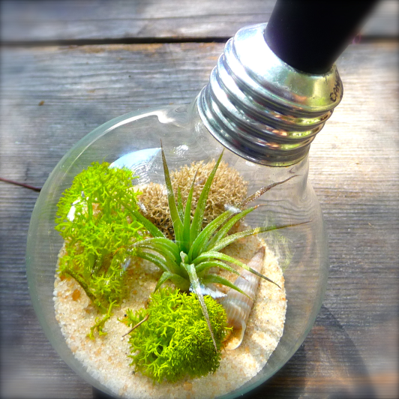
Learning Targets:
Analyze 7th grade curriculum content.
Review for the final exam.
Artificial Eco-Systems
  Zoo
  International Space Station
  A Terrarium

Slide 21
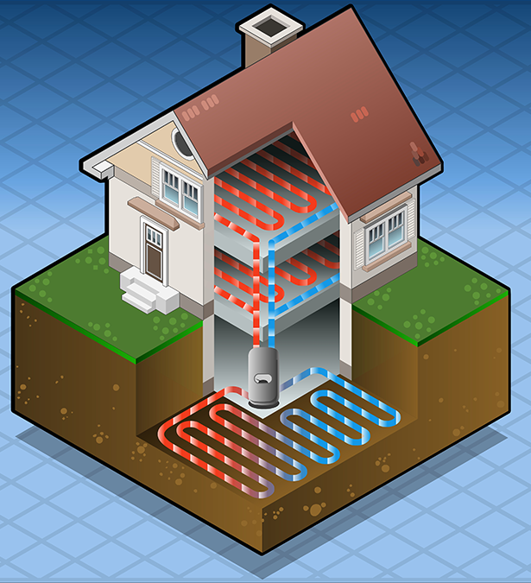
Learning Targets:
Analyze 7th grade curriculum content.
Review for the final exam.
Eco-Friendly homes
  Geo-thermal technology
  Prefix: Geo- means “Earth”
  Thermal means “heat”
Not Eco-Friendly
  Air conditioners
  Electric heaters
  Wood furnace

Slide 22

Learning Targets:
Analyze 7th grade curriculum content.
Review for the final exam.
Eco-friendly and “green” technology
  Prefix: Eco- means “Earth”
  Have little or zero negative effects to the planet

Slide 23
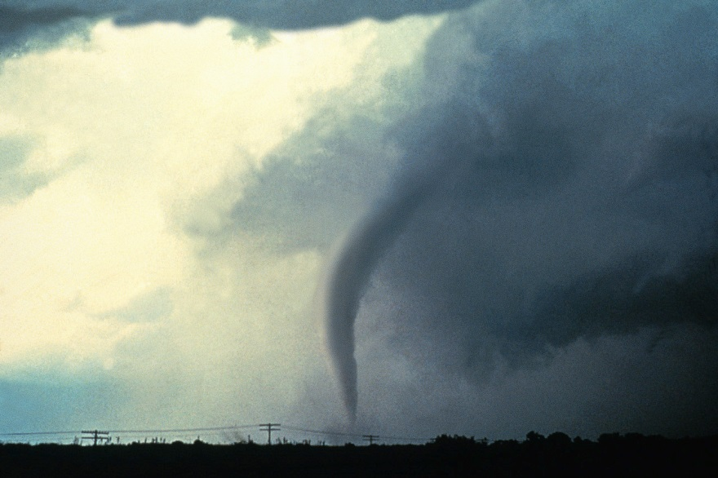
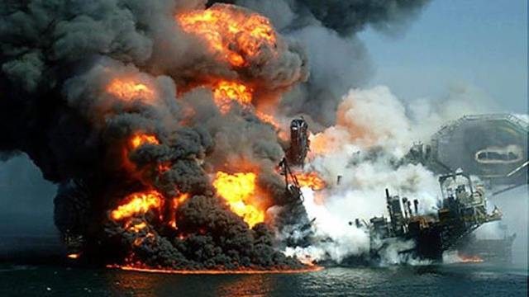
Learning Targets:
Analyze 7th grade curriculum content.
Review for the final exam.
Natural Disasters
  Hurricanes
  Tornados
  Tsunamis
Human Disasters
  Oil spills
  Nuclear explosions
  Forrest fires

Slide 24

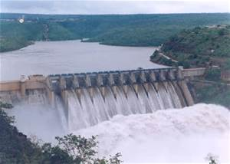
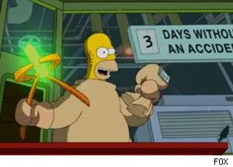
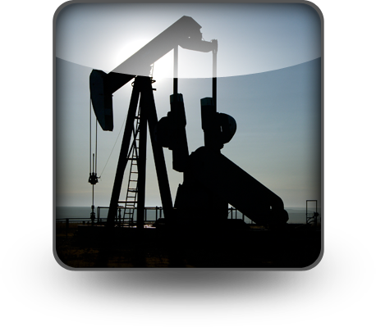
Learning Targets:
Analyze 7th grade curriculum content.
Review for the final exam.
Renewable resources – can use over and over
  Sun
  Wind
  Air
  Water
Non-renewable resources – once used, cannot be replaced
  Coal
  Oil
  Gas
  Uranium

Slide 25

Learning Targets:
Analyze 7th grade curriculum content.
Review for the final exam.
Our Moon
  Daytime temp 253° F
  Nighttime temp -387° F
  630° F difference!
  Why?
    No atmosphere to block sun’s
    rays during the day, or to hold
    the heat in during the night.

Slide 26
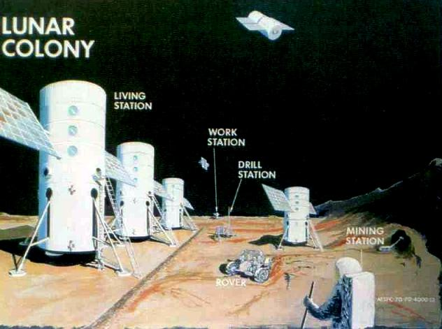
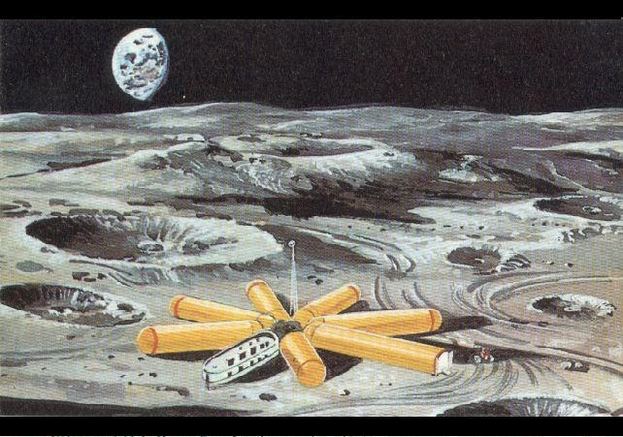
Learning Targets:
Analyze 7th grade curriculum content.
Review for the final exam.
Lunar Colony Concepts
  Lunar (Moon)

Slide 27
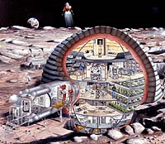
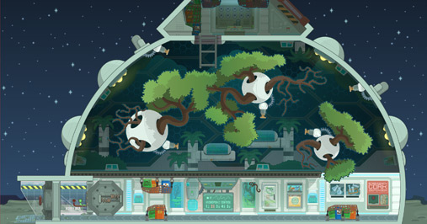
Learning Targets:
Analyze 7th grade curriculum content.
Review for the final exam.
Lunar Colony Concepts
  Lunar (Moon)

Slide 28
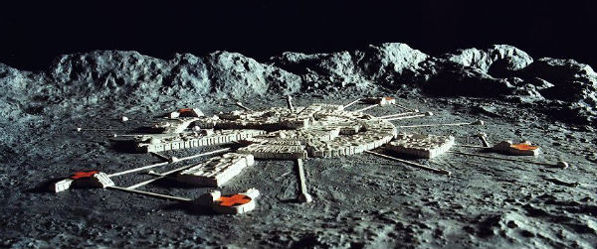
Learning Targets:
Analyze 7th grade curriculum content.
Review for the final exam.
Lunar Colony Concepts
  Lunar (Moon)

Slide 29
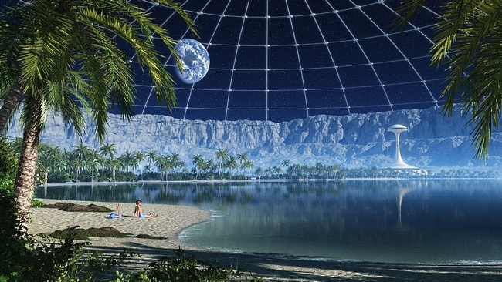
Learning Targets:
Analyze 7th grade curriculum content.
Review for the final exam.
Lunar Colony
  Best energy source to use – Solar Power
  Self-sufficient: Does not need any aid or assistance to work properly

Slide 30

Learning Targets:
Analyze 7th grade curriculum content.
Review for the final exam.
Questions?
Review.

